Slide 1

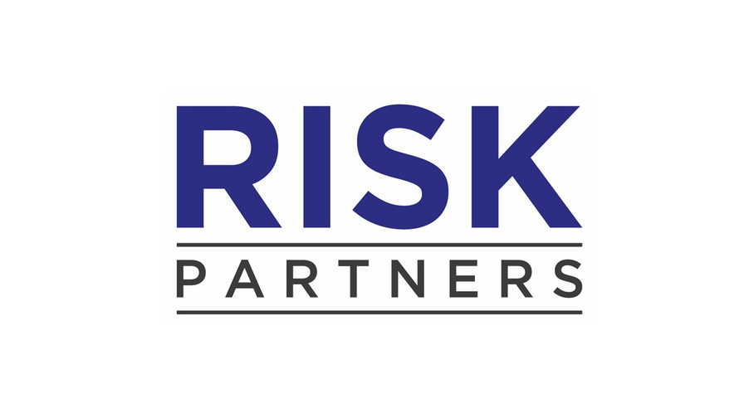
www.theriskpartners.com

Slide 2

INTRODUCTION
"Trusted Partners in Global Risk, Compliance & Governance Recruitment"
The Risk Partners, are a boutique Headhunter, focused on the
delivery of talent within the Risk, Compliance and Governance space.
02
02

Slide 3

OUR CLIENTS
We work in partnership with our clients across the spectrum of Financial Services & Commodities Trading.
(This includes Banking, Asset & Investment Management, Consulting and Fintech)
03

Slide 4

CORE EXPERTISE
RISK MANAGEMENT
Credit Risk
Market Risk
Operational Risk
Quantitative Risk
Enterprise Risk
Technology Risk
Cyber Security
Information Security
Business Resilience / Business Continuity
COMPLIANCE
Advisory
Financial Crime
Regulatory Compliance
Monitoring
Generalist Compliance
04

Slide 5

WHERE WE OPERATE
We support clients across the globe, with notable examples including:
USA
New York
Denver
San Francisco
Los Angeles
Chicago
MIDDLE EAST
Doha
Dubai
Riyadh
Abu Dhabi
Manama
EUROPE
London
Paris
Luxembourg
Frankfurt
Brussels
Copenhagen
05

Slide 6

WHY WORK WITH US
  Long-standing track record in recruiting for Risk & Compliance positions
  Trusted by the worlds biggest brands
  Access to a Global network of candidates
  Knowledge of market trends and availability of talent
  Ability to provide Permanent or Interim staff for your organisation
06

Slide 7

OUR VALUES
"Acting with Honesty, Sensitivity and Professionalism"
  We will help you however we can and are solution driven
  You will always get an honest answer - it’s the least our clients deserve
  Discretion and adherence to your brand values
  We are nice people to deal with and believe in working together!
07

Slide 8
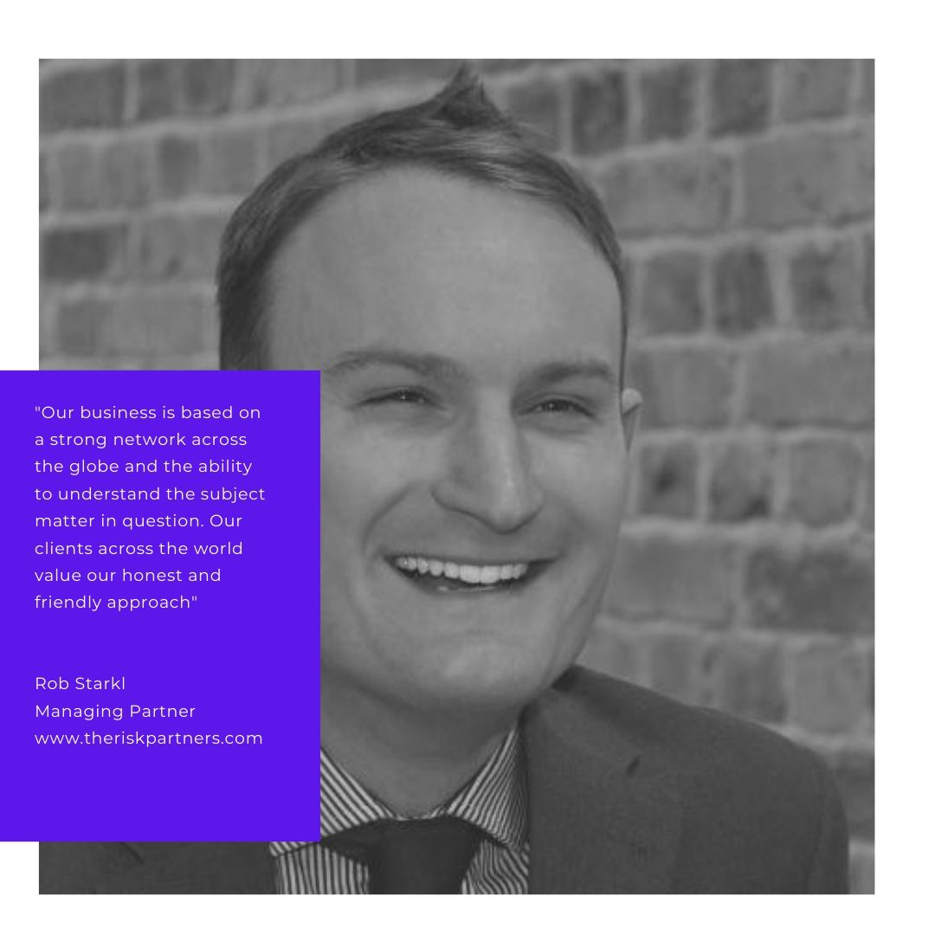
A WORD FROM OUR MANAGING PARTNERS
08

Slide 9
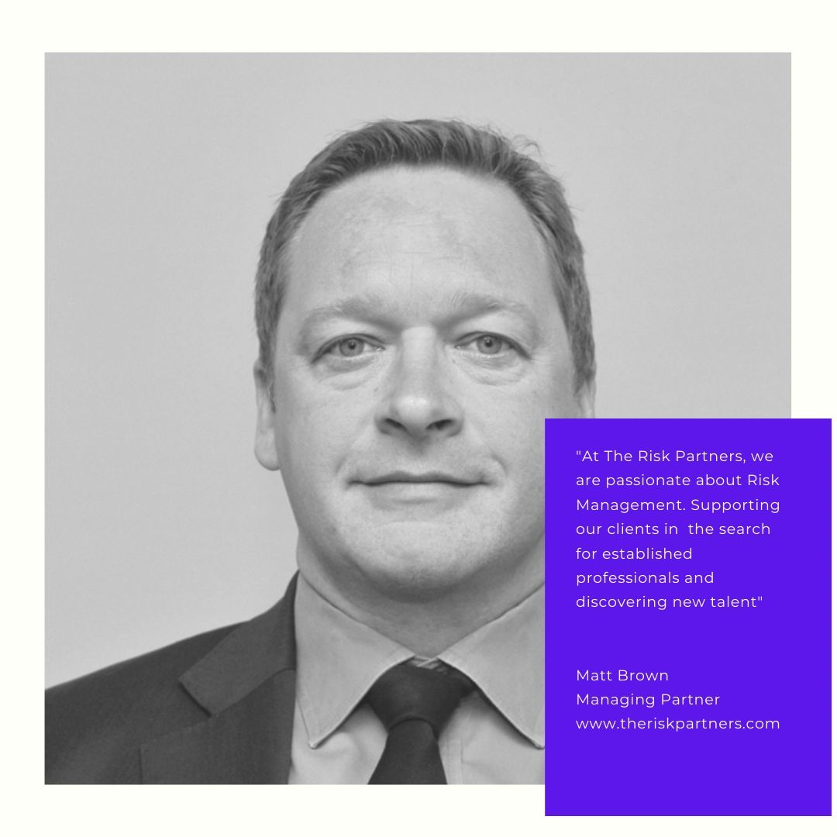
A WORD FROM OUR MANAGING PARTNERS
09

Slide 10

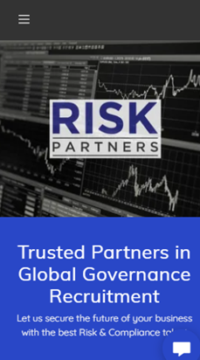



CONTACT
www.theriskpartners.com
contact@theriskpartners.com
10

